Slide 1
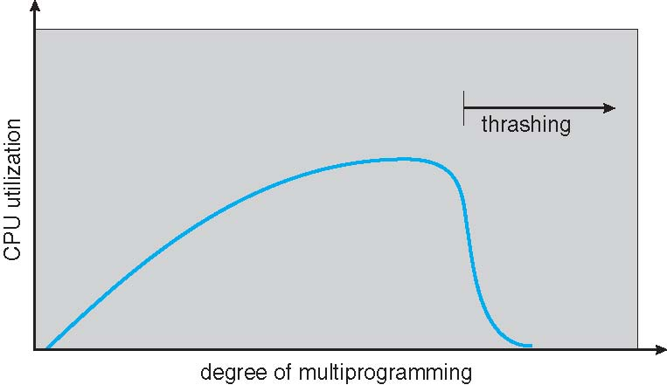

Thrashing

Slide 2
Thrashing
Thrashing ≡ a process is busy swapping pages in and out

Slide 3
Thrashing (cont)
Why does demand paging work? Locality model
Why does thrashing occur? Σ size of locality > total memory size

Slide 4
Thrashing (cont)
Why does demand paging work? Locality model
Why does thrashing occur? Σ size of locality > total memory size
Solution
Working set model
Page fault frequency

Slide 5
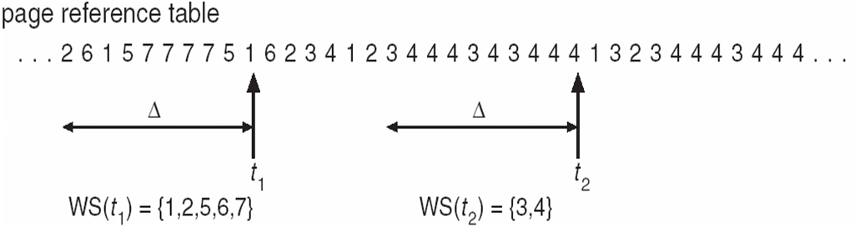
Working set model
WSS_{i} (working set of Process P_{i}) = total number of pages referenced in the most recent Δ (varies in time)
if Δ too small will not encompass entire locality
D = Σ WSS_{i} ≡ total demand frames
Approximation of locality
if D > m ⇒ Thrashing

Slide 6
Working set model
WSS_{i} (working set of Process P_{i}) = total number of pages referenced in the most recent Δ (varies in time)
if Δ too small will not encompass entire locality
D = Σ WSS_{i} ≡ total demand frames
Approximation of locality
if D > m ⇒ Thrashing
Policy if D > m, then suspend or swap out one of the processes

Slide 7
Page-Fault Frequency
More direct approach than WSS
Establish “acceptable” page-fault frequency (PFF) rate and use local replacement policy
If actual rate too low, process loses frame
If actual rate too high, process gains frame

Slide 8
Page-Fault Frequency
More direct approach than WSS
Establish “acceptable” page-fault frequency (PFF) rate and use local replacement policy
If actual rate too low, process loses frame
If actual rate too high, process gains frame

Slide 9
Page-Fault Frequency
More direct approach than WSS
Establish “acceptable” page-fault frequency (PFF) rate and use local replacement policy
If actual rate too low, process loses frame
If actual rate too high, process gains frame

